Slide 1
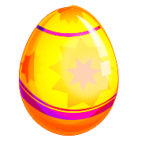



EASTER
VOCABULARY

Slide 2
bunny

Slide 3
Easter eggs

Slide 4
basket

Slide 5
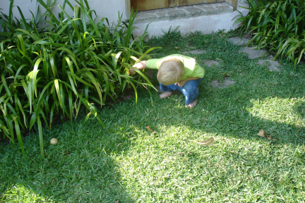

egg hunt

Slide 6
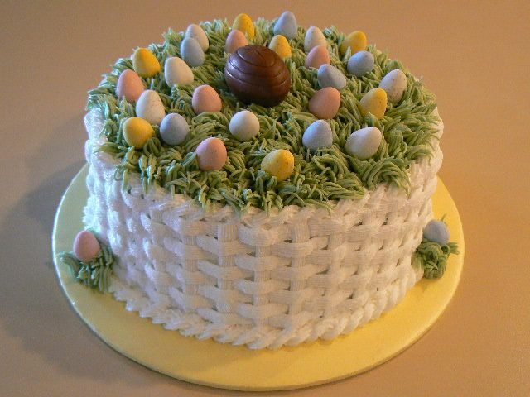
Easter cake

Slide 7
lamb

Slide 8
spring

Slide 9
chicks

Slide 10
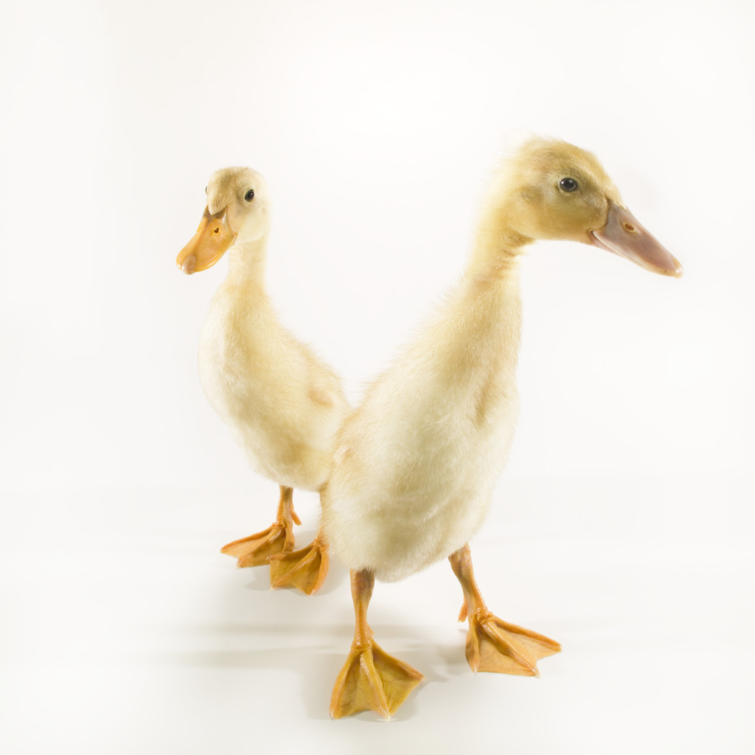
ducklings

Slide 11
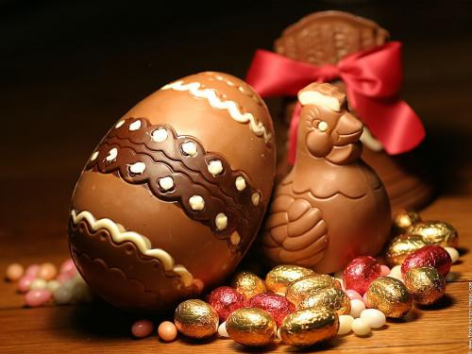
chocolate

Slide 12
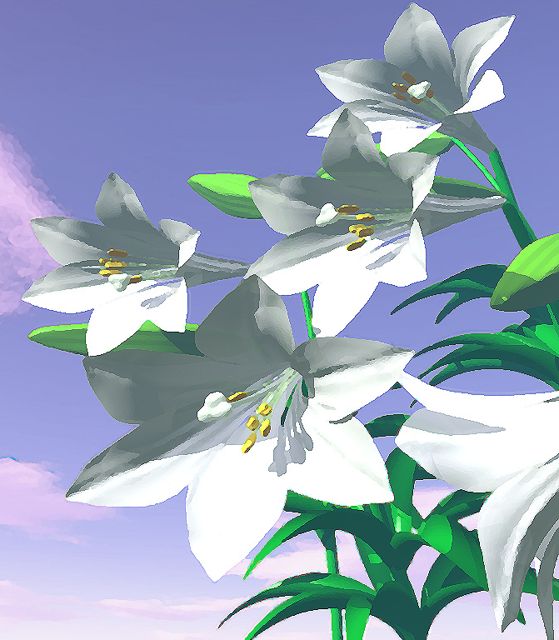

lillies

Slide 13
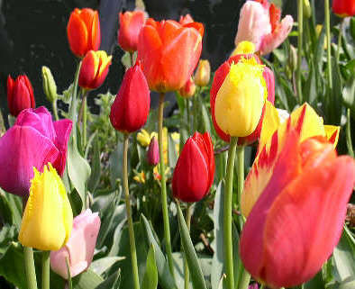
tulips

Slide 14
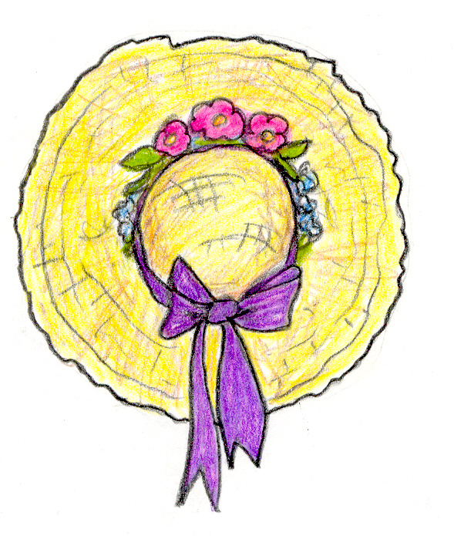
Easter bonnet

Slide 15
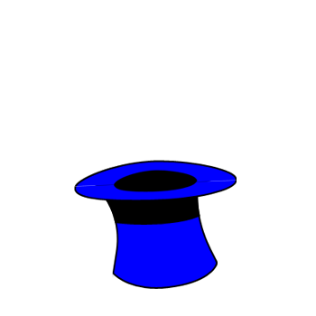

Slide 16
http://efl-fle-chezvous.monsite-orange.fr/
Janet Mournard

