Slide 1
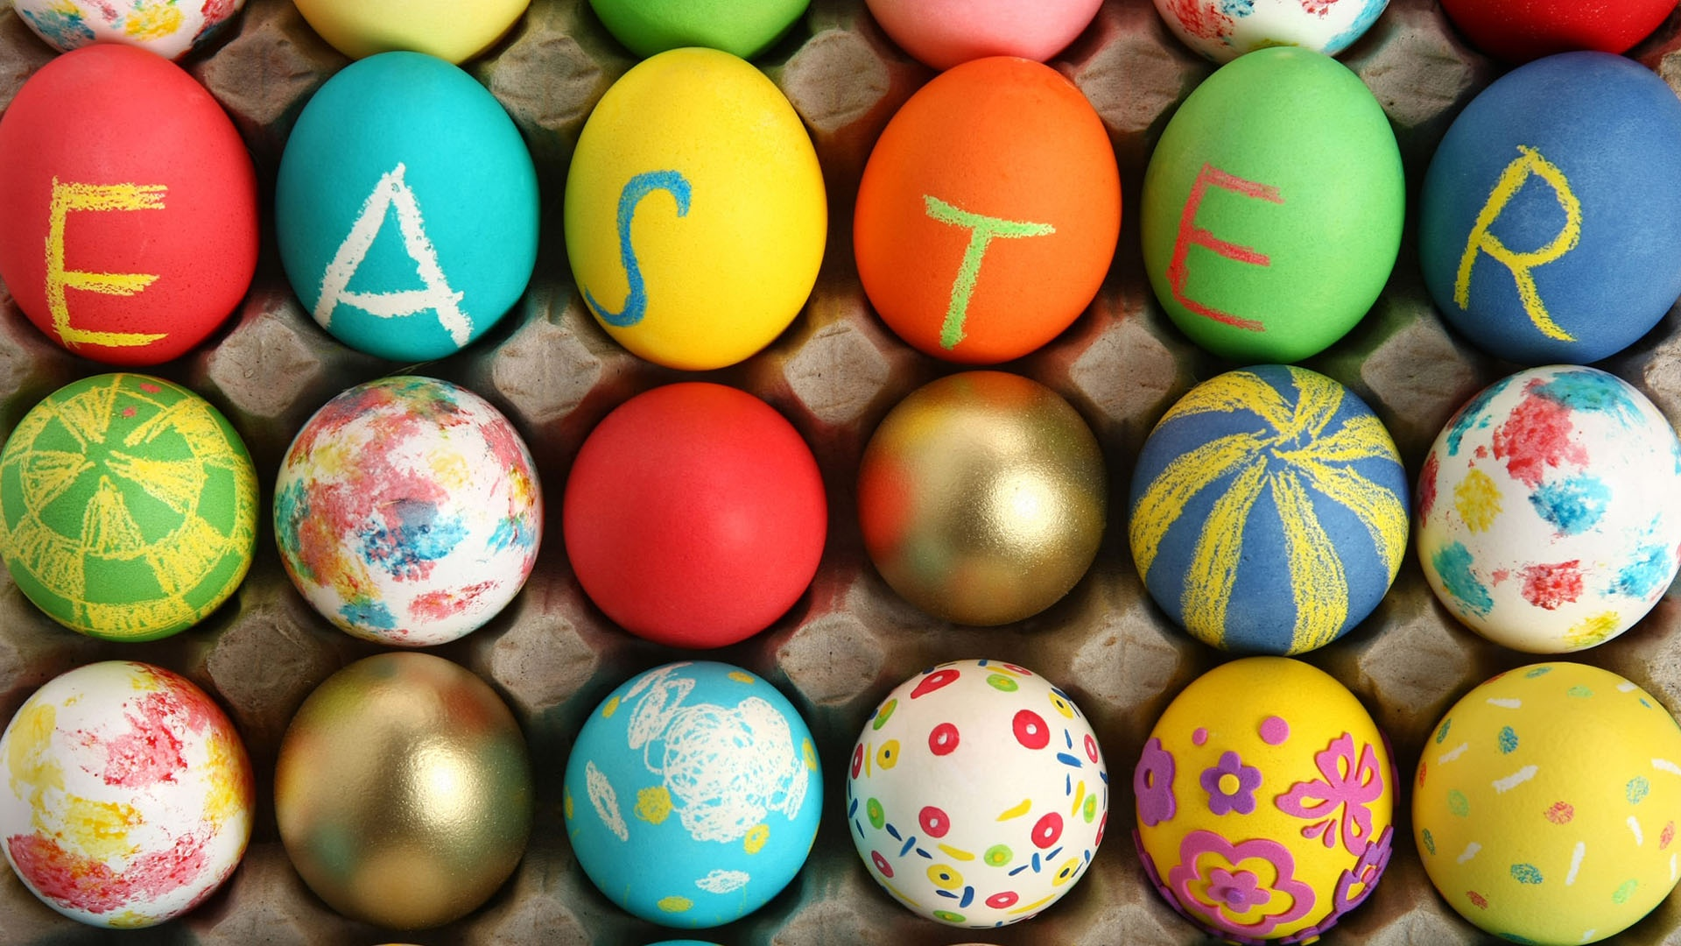

Slide 2
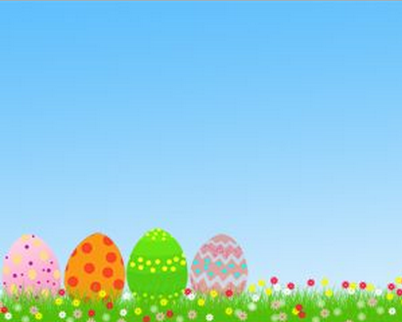
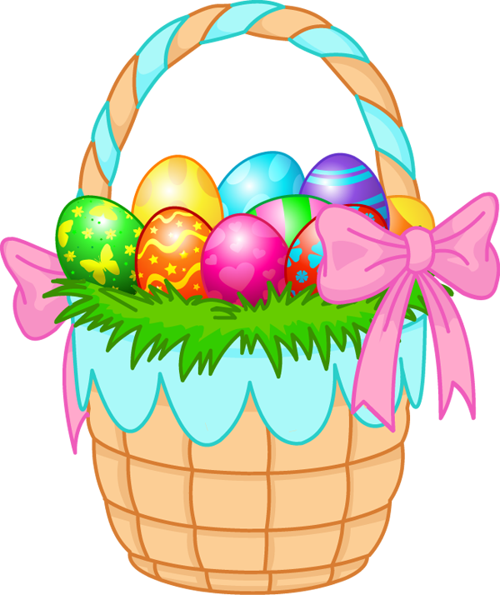
Basket

Slide 3
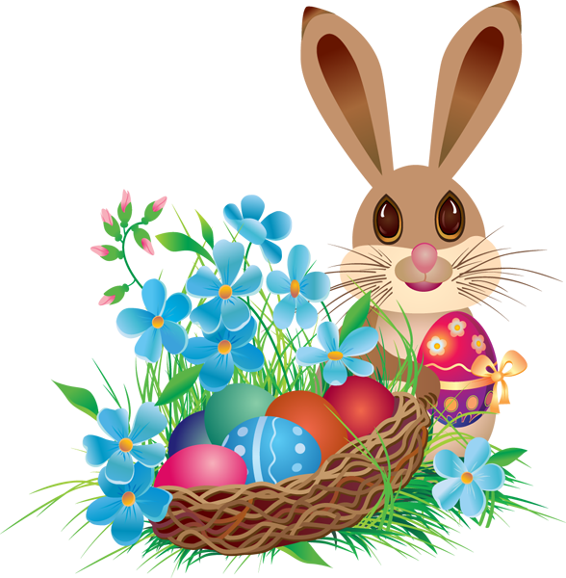
Bunny

Slide 4
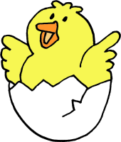
Chick

Slide 5
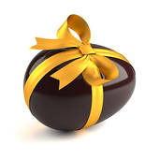
Chocolate egg

Slide 6
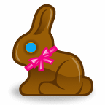
Chocolate bunny

Slide 7

Church

Slide 8

Cross

Slide 9

Daffodil

Slide 10
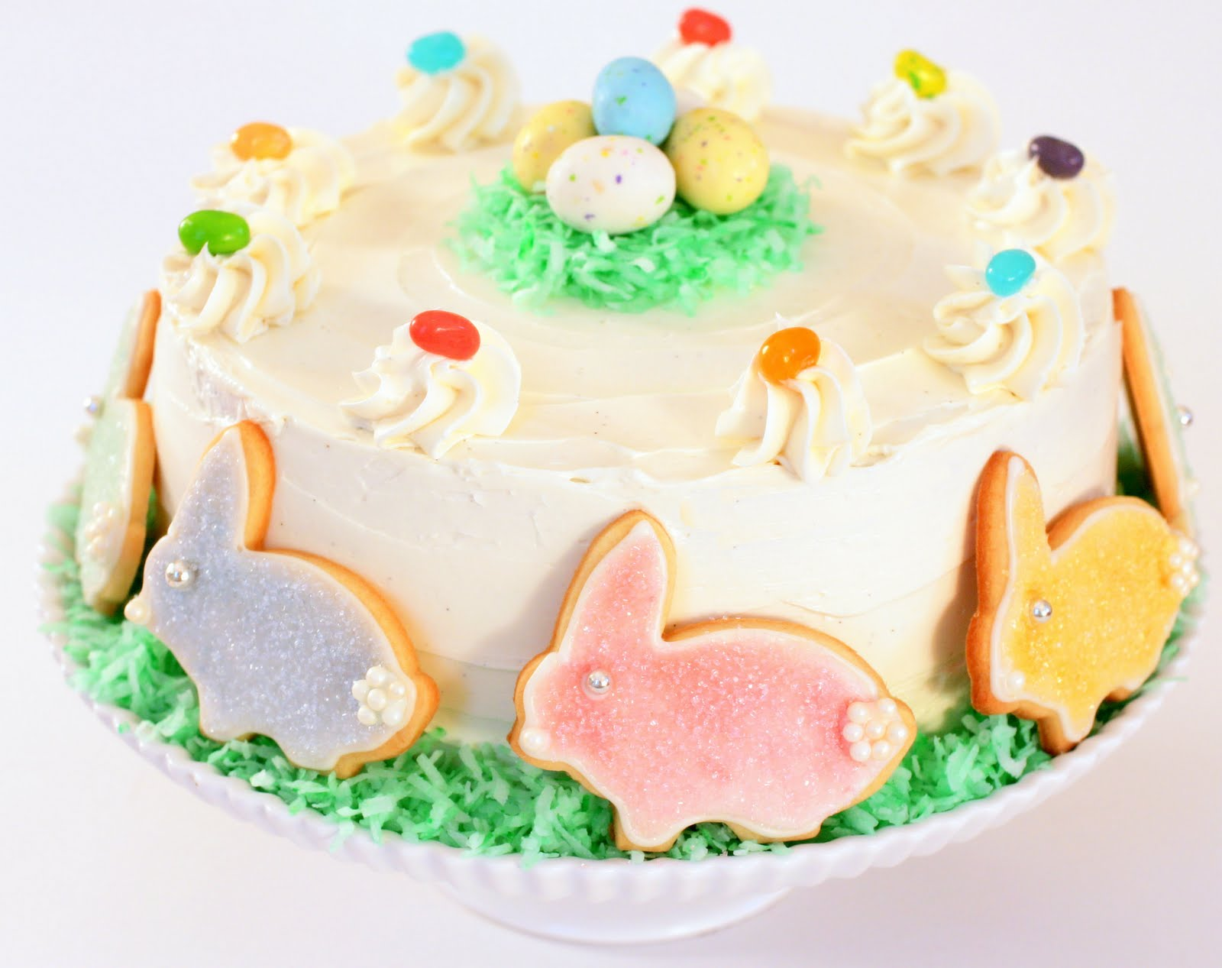
Easter cake

Slide 11
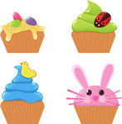
Easter cupcakes

Slide 12
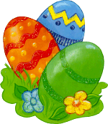
Easter eggs

Slide 13
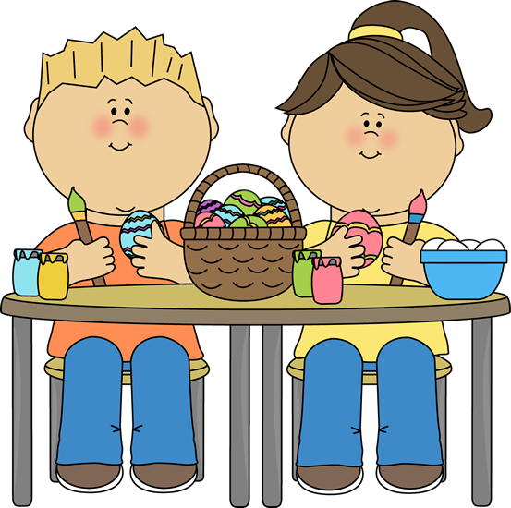
Egg painting

Slide 14
Egg hunting

Slide 15
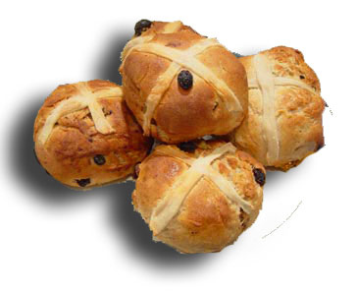
Hot cross buns

Slide 16

Holy Bible

Slide 17
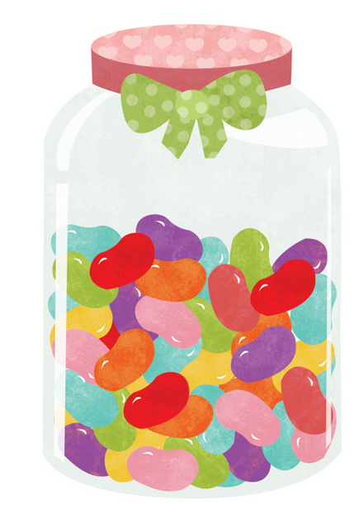
Jelly beans

Slide 18
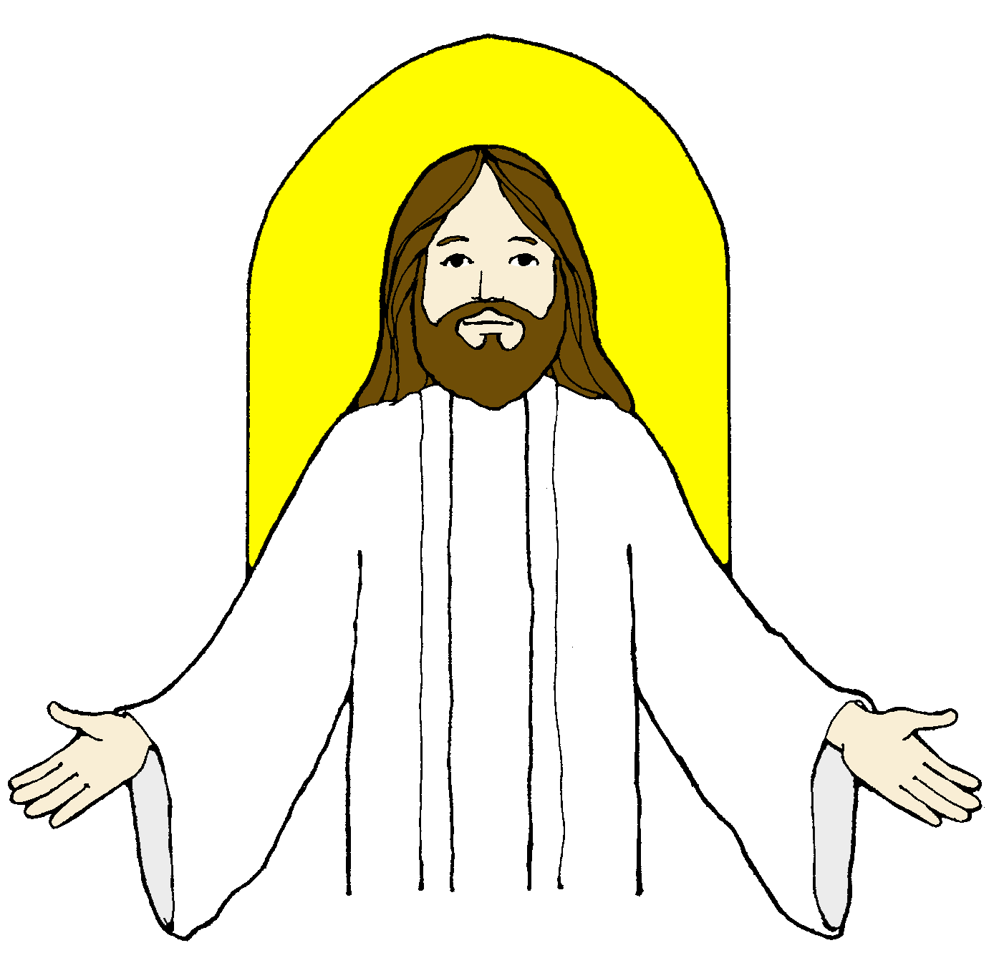
Jesus Christ

Slide 19
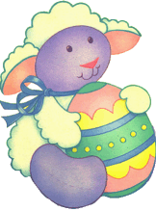
Lamb

Slide 20

Lily

Slide 21

Tulip

Slide 22
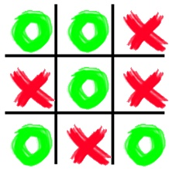
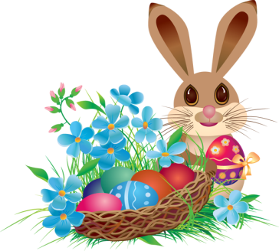
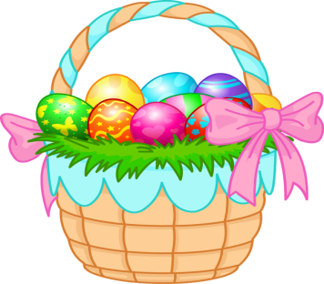

Noughts and Crosses

Slide 23
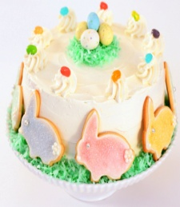


Noughts and Crosses

Slide 24
Noughts and Crosses

Slide 25

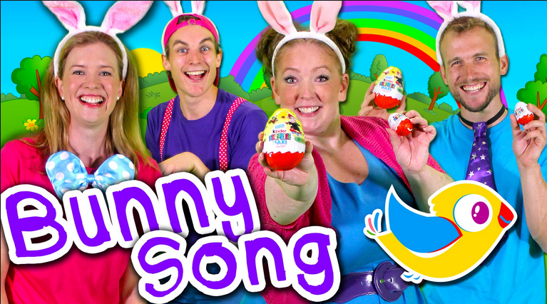
SONG:
Easter Bunny Bop!

Slide 26
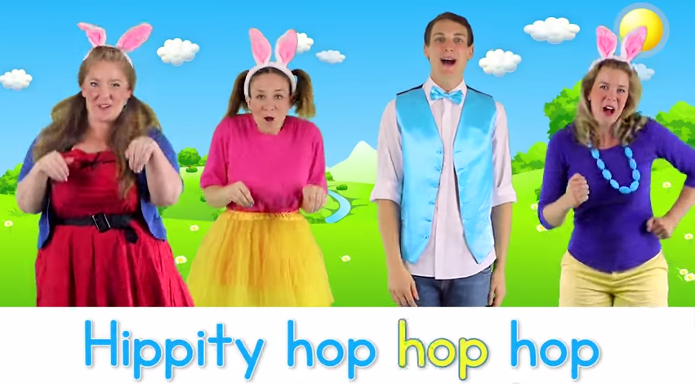
SONG:
Hippity Hop

Slide 27
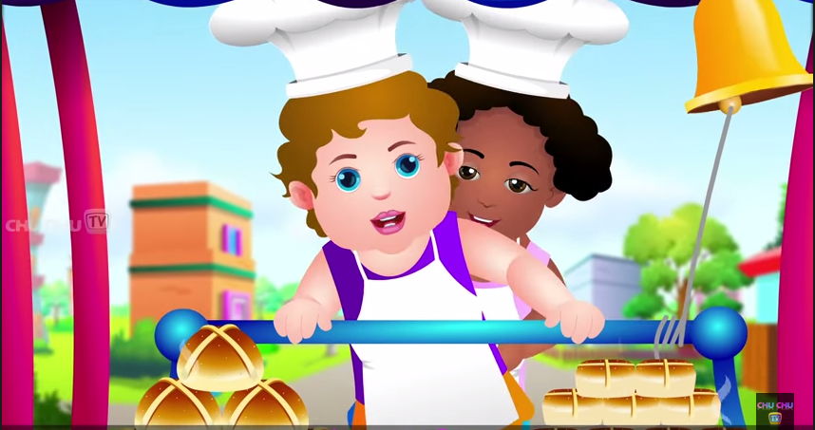
SONG:
Hot Cross Buns

Slide 28
